Slide 1
Capstone Project
GIF ACCESSIBILITY READER: LOCAL ML REBUILD & MODEL COMPARISON
Present by: Jason Xu
Faculty Advisor: Min Chen

Slide 2
Overview
GIFs are widely used across social platforms but remain largely inaccessible to visually impaired users because screen readers cannot describe motion or visual context.
The original GIF Accessibility Reader (2023) produced only single-frame captions and relied on a heavy, outdated codebase.
This project modernizes the entire system, simplifies the backend, and introduces a multi-model evaluation pipeline to identify the best captioning strategy for animated GIFs.

Slide 3
Objective
Analyze the legacy codebase
Identify outdated components, broken dependencies, and remove unsupported modules
Rebuild the backend architecture using FastAPI.
Integrate new modern ML models
Modernize and adapt reused components
Benchmark accuracy, and runtime
Compare single-frame vs multi-frame captioning.
Analyze limitations of different models

Slide 4
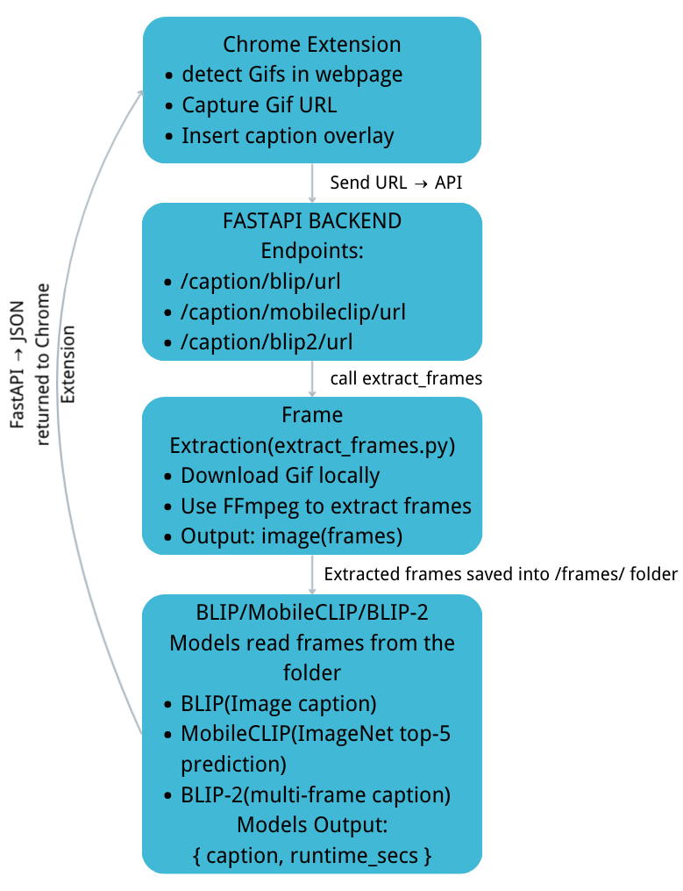
Architecture

Slide 5
Models
BLIP: Strong baseline, fast, reliable image captioning.
MobileCLIP: Evaluate whether a CLIP model can provide useful labels for GIFs.
BLIP-2: Capable of reasoning over multiple frames, provides the upper bound of captioning quality to compare against the other two models.

Slide 6
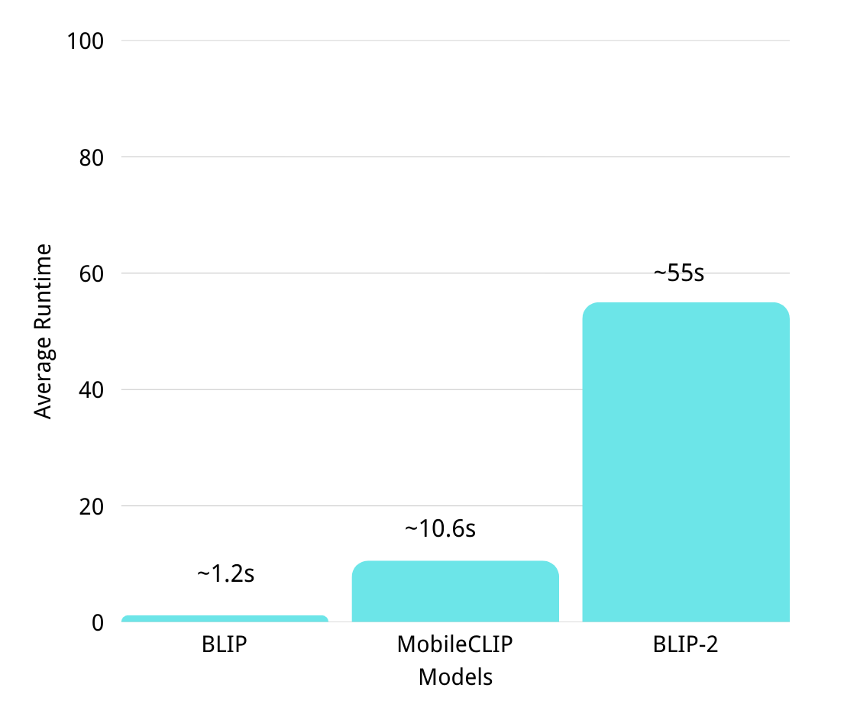
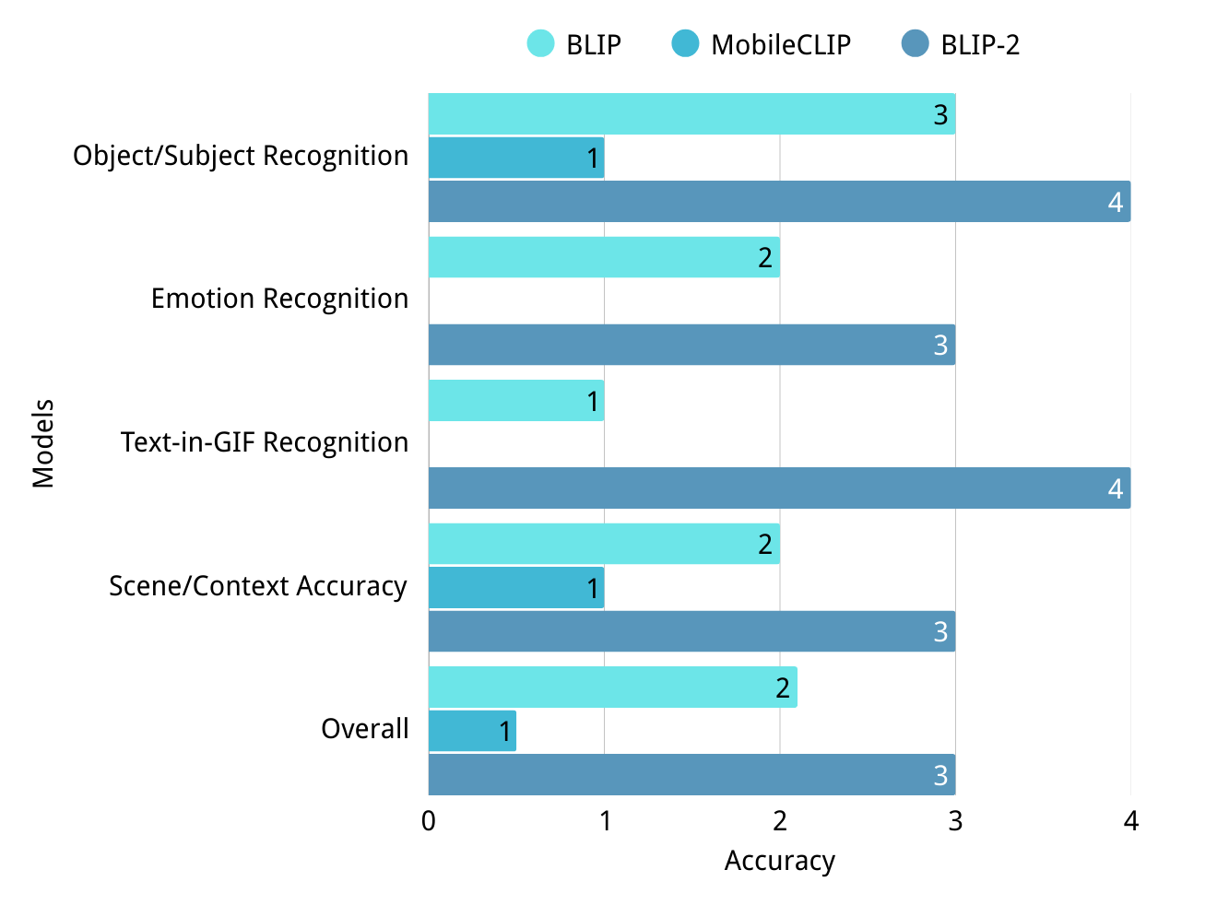
Outcomes

Slide 7
Limitations
BLIP is fast and able to describe the object and subject in a GIF but struggles with emotions and text inside GIF.
MobileCLIP can’t generate full sentences. Outputs are often inaccurate single-word classifications.
BLIP-2 is more detailed and accurate is than BLIP in most of the cases, but it is significantly slower than the other. models

Slide 8
Why?
BLIP is an image captioning model, it only captions one frame, so it often misses motion-based context in GIFs.
MobileCLIP is a CLIP-style embedding model, not a generative model. It only outputs the closest ImageNet class, which explains the single-word labels.
BLIP-2: Processing multiple frames requires cross-attention across all frames, which dramatically increases compute cost. Our system runs BLIP-2 on CPU, not GPU, so it becomes even slower due to the model’s size.

Slide 9
Optimization
Run BLIP-2 on a GPU with ≥ 12–16 GB VRAM instead of CPU
Host BLIP-2 on a cloud GPU service for scalability.(e.g., Google Colab Pro)

Slide 10
Conclusion
Successfully rebuild the GIF Accessibility locally, modernize all components and compares different pre-trained models.
The evaluation clearly shows:
BLIP → Best for live accessibility
BLIP-2 → Best quality, but need optimization
MobileCLIP → Not appropriate for caption generation

Slide 11
Future work
Integrate real video-caption models (VideoLLaMA, OpenFlamingo)
Use GPU-accelerated inference
Deploy as a web service for public accessibility use

Slide 12
What I learned
How to work with modern ML pipelines
How to rebuild and modernize a large legacy codebase
FastAPI backend design and API structuring
Model evaluation and benchmarking skills
Understanding Chrome Extensions and web integrations

Slide 13
Related Coursework
CSS 301 — Technical writing
CSS 360 — Software Engineering
CSS 370 — Analysis & Design
CSS 481 — Web Programming & Applications

Slide 14
Acknowledgements
This project builds on previous research from the GIF Accessibility Reader team
Special thanks to Professor Min Chen for guidance and project direction

Slide 15
Q & A

